Slide 1
Computer Principles for Programmers
IT Projects, IT Jobs, and Project Management
Turn on recording
Notes:
Set up for video
https://www.youtube.com/watch?v=vTwJzTsb2QQ

Slide 2
News of the Week

Slide 3
Agenda
Lecture:
Tech Careers and Opportunities
What is “Project Management?”
What are some typical “IT Projects?”
What does a Project Manager do?
Project Management Process Groups: Initiation, Planning, Executing, Controlling, Closing.
Advantages of Project Management
What is Project Management Certification?

Slide 4
Agenda (Cont’d)
Activity:
An activity to work on project management processes

Slide 5
Tech careers in 2020
Position | Salary 25th% | Salary 75th%
Developer/Programmer Analyst: Java, JavaScript, Python, C# .NET, C / C++ | $64,750 | $91,500
Quality Assurance Analyst | $62,000 | $90,000
Business Systems Analyst | $67,000 | $117,500
Database, SQL and NoSQL | $60,000 | $108,000
Project Manager: PMP, Agile, Scrum | $90,750 | $131,000
https://www.roberthalf.ca/en/salary-guide/technology
Notes:
Making up approximately 7% of the economy, Canada’s tech industry has 488,000 IT professionals.
https://www.itworldcanada.com/article/more-data-needed-to-help-it-professionals-future-proof-their-careers/423606
"IT is the fastest growing sector in Canada in terms of job creation, according to human resources firm, Randstad Canada. Toronto is the fastest-growing market for tech jobs in the world, Ottawa and Montreal are in the top 15 fastest growing IT job markets. Randstad reported that the top in-demand skills in 2019 are coding and programming. In ITWC’s 2019 CIO Census, tech leaders said they’re most in need of finding skilled enterprise app developers as well as data and business analysts.
NoSQL = "non SQL" or "non relational" and also Not Only SQL
https://www.randstad.ca/hot-jobs/technology-jobs-in-demand/#titles
https://www.randstad.ca/hot-jobs/technology-jobs/technology-jobs-in-toronto/
Per 2020 guide from https://www.roberthalf.ca/en/salary-guide/technology (scroll down the page for Salary Calculator inquiry form and in-demand skills and positions)
Software developer. I primarily write code and develop applications that are not hosted in a cloud environment.
Cloud developer. I primarily write code and develop applications that are hosted in the cloud.
Cloud native developer. I primarily write applications in cloud environments using containerization or serverless technologies.
IT decision maker. I oversee and/or set the strategy for IT activities including tools and technologies to be used by my team/organization.
IT professional. I perform IT activities to support my organization or team.
Data professional. I build, run or oversee data mining, advanced algorithms or models.
Business decision-maker. I spend my time on non-technical activities but have some oversight and responsibility for IT functions and budgets.
Industry Certifications
Application Development / Programming
Business analysis
Cloud Architect
Cybersecurity/Information Security
Data Analyst
Developer
DevOps Engineer
Ethical Hacker
Networking
Project Management Professional
Risk and Information Control
Solutions Architect
Scrum Master
Virtualization
http://www.techproresearch.com/downloads/the-future-of-it-jobs-a-business-leader-s-guide-copy1/
https://www.ic.gc.ca/eic/site/ict-tic.nsf/eng/home
http://itac.ca/our-industry-our-profile/
https://www.itactalent.ca/wp-content/uploads/2014/06/ICT-%E2%80%93-The-Engine-of-Growth-in-Canada-%E2%80%93-Infographic.jpg
https://globalnews.ca/news/3417919/the-10-best-jobs-of-2017-in-canada-according-to-indeed-ca/
https://shawglobalnews.files.wordpress.com/2017/05/topjobscanada-indeed.jpg?quality=70&strip=all&strip=all
https://www.jvstoronto.org/blog/job-in-demand-the-growing-information-communications-and-technology-sector-in-canada/
https://hired.com/state-of-software-engineers#hottest-jobs

Slide 6
Tech Opportunities
Developer Skills
Problem Solving, Soft Skills
AngularJS, Node.js, React
Growth Industries
FinTech, Healthcare, Robotics
Transportation and Logistics
Digital Transformation (DX)
SaaS via Web & Mobile, Cloud containers & serverless platforms
Analytics, Big Data, Cloud–Edge Computing, IoT, Security + Privacy
AI / ML, Blockchain, 5G real time computing
Notes:
We write code to solve problems; but they pay us to solve problems, not to write code.
Employers want people who can work with other people, not just computers. soft skills: Personal attributes that enable someone to interact effectively and harmoniously with other people.
Employers want people who can assume blended roles – like Business Systems Analysts — who have both specialized technical expertise and solid array of soft skills. These are perennial skills.
The perennial skills employers have always wanted include Problem Solving, Soft Skills – People and Teamwork, and communication skills at the level you see in the business sections of Toronto newspapers.
https://www.ictc-ctic.ca/wp-content/uploads/2017/07/ICTC_Outlook-2021-ENG-Final.pdf
Continuing Tech areas: social, mobile, apps, analytics and cloud technologies under Internet of Things (IoT)
Highest demand for skilled workers in the digital economy:
Jobs in Robotics are Bringing back jobs in Manufacturing
5G should deliver 1 Gbps in practice, up to 10Gbps theoretical, low latency (1 – 9ms), low power consumption (10 year battery life for IoT), high density edge computing at least 1 million connected devices per square kilometre; improved bandwidth + low latency + reliability allow real time mesh networking infrastructure for edge computing
fifth generation (5G) mobile technology will enable real time systems in the Tactile Internet: virtual reality (VR) and augmented reality (AR), gaming, , remote and robotic surgery. enables cooperative vehicles & vehicle-to-vehicle (V2V) communication, drone control
Factory automation is a favorite example of low-latency advantages. 5G connecting robots so they can coordinate their actions and avoid running into each other. 5G also could let robots communicate wirelessly instead of with network cables, untethering them so a factory can rapidly switch manufacturing jobs. 5G sensors for Quality control.
https://www.gemalto.com/brochures-site/download-site/Documents/tel-5G-networks-QandA.pdf
https://www.cnn.com/2019/03/22/tech/5g-factory-manufacturing/index.html 5G sensors directly on components or tools enable fault detection in real time and reduce the error rate from 25% to 15%. The average production cost of a turbine blade was reduced by €3,600 ($4,075).
"With one millisecond latency, you can sense whether there is a deviation in the process before the tool even hits the blade and you can stop the machine before the error happens," said Åsa Tamsons, a senior vice president at Ericsson.
innovative industries such as advanced manufacturing, agri-food, clean technology, digital technology, health/biosciences and clean resources, as well as infrastructure and transportation. This also include "Fintech" Finance Technology, or companies that use innovative technology to revamp everything from banking to fraud security.
These initiatives require a range of skills including project managers.
http://www.theglobeandmail.com/report-on-business/canadian-fintech-companies-shine-as-venture-capital-investments-near-record/article33476692/
BIG data. 1.7MB is not a lot of data anymore. But 1.7MB of data generated every second is a lot: 86.4GB every day which is going to add up. And in 2020, that 86.4GB/day will happen for every person on Earth generating about 655 Exabytes per day (Giga –> Tera –> Peta –> Exa). We are generating hundreds of Exabytes every day now. "Over the last two years alone [2017-2018], 90 percent of the data in the world was generated." – by 2018, the world had TEN TIMES as much data as in 2016. 6 billion smartphones will be in service in 2020. And IoT is just getting started. https://www.forbes.com/sites/bernardmarr/2018/05/21/how-much-data-do-we-create-every-day-the-mind-blowing-stats-everyone-should-read/ "By next year [2020], roughly 1.7 megabytes of data will be generated each second for every person in the world." https://www.theglobeandmail.com/investing/article-quandl-and-the-invasive-use-of-data/
https://www.weforum.org/agenda/2019/03/citizen-science-can-help-solve-our-data-crisis/
https://www.google.com/search?q=how+5g+will+change+the+world
https://www.thorntech.com/2018/08/containers-vs-serverless/
https://www.cloudflare.com/learning/serverless/serverless-vs-containers/

Slide 7
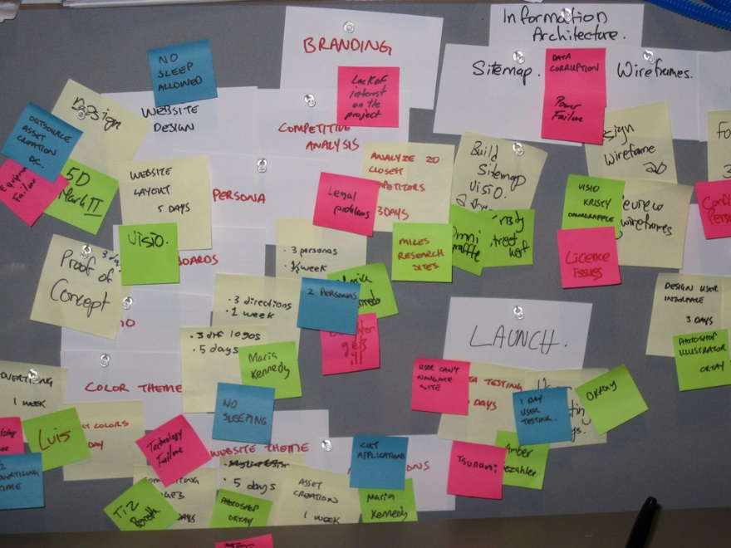
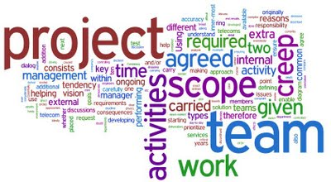
PROJECT
Business Systems Analysis – What's the problem?
System Development – What's the solution?
Project Management – Make it happen!
Notes:
Cost effective software delivered in a timely manner needs good analysis, good design, and good management. Why? If it costs $1 to identify a business requirement at the beginning of a project, it costs $100+ to add it after Going Live. The $1 cost is good management, the $100+ is bad management.
We had better know what we are doing. “good IT is expensive and bad IT is even more expensive”
For every complex problem there is a solution which is clear, simple, and wrong." -- H L Mencken.
Peer's Law: The solution to the problem changes the problem.
Sevareid's law: The chief cause of problems is solutions.
example of a good project:
https://www.itworldcanada.com/article/sap-and-ibm-are-just-the-ticket-for-the-toronto-transit-commission/414648

Slide 8
What is Project Management?
It's just like herding cats
Notes:
https://www.youtube.com/watch?v=vTwJzTsb2QQ
https://en.wikipedia.org/wiki/Cat_Herders

Slide 9
What is Project Management?
…something employers want you to know!
Programming is just one aspect of creating a solution.
IT Project Mgmt is responsible for the whole solution.
"Project management is the application of knowledge, skills, tools and techniques to project activities to meet project requirements." -- Project Management Body of Knowledge (PMBOK) Guide from pmi.org
Notes:
The School of ICT has Industry Advisory Committees who advise us on what they want to see in our CPD & CPA graduates. Some of the technical skill sets change over time but they always ask that our graduates know about Project Management.
Project management is the application of knowledge, skills, tools and techniques to project activities to meet project requirements.
Project Management is the “discipline of initiating, planning, executing, controlling, and closing” the work of a team “to achieve specific goals and meet specific success criteria.”
Scope Management includes the processes required to ensure that the project includes all the work required, and only the work required, to complete the project successfully. Managing the project scope is primarily concerned with defining and controlling what is and is not included in the project.
https://blog.usejournal.com/information-is-the-key-to-excellence-in-software-engineering-teams-b40aa1c83ab0 Your people are your most important asset in any organisation. They need the tools to do their jobs to the best of their ability. And knowledge is the best tool you can arm them with.
They are on your team because, individually, they have the skills the project needs. A PM's job is to be in the service of their team, not to order them around. A PM's role is to provide them with good systems to access and share information so they can produce the best possible outcome. A PM's job is to facilitate communication within the team and between the team and the client's key users and business experts.

Slide 10
Scale of Projects
Liberal Government March 2017 & 2018 budgets
$125-million Pan-Canadian Artificial Intelligence Strategy
$950 million for Innovation Clusters over five years.
Phoenix Pay: $5.7M → $185M → $307M + $659M + $16M 2011 2016 2017 2018-24 2018-19 software est swr actual total costs future costs research Go Live Feb & April, 2016 new system
Phoenix scope: 290,000 employees, 34 HR/payroll systems, 105 contracts, 80,000 pay rules in 200 custom modules – not all implemented at roll out. 1,000 bugs by Jan.2017. As of Sept.2019, 228,000 transactions with financial impact outstanding affecting > ½ of all federal employes
Notes:
July 2009, the federal gov/t approved funding for a $310-million Public Works initiative called Transformation of Pay Administration Initiative. The Phoenix project was intended to replace Canada's 40-year old system with a new, cost-saving "automated, off-the-shelf commercial system" to serve "101 departments and nearly 300,000 employees".
By end of 2016, Phoenix caused pay problems to close to 80 percent of the federal government’s 290,000 public servants through underpayments, over-payments, and non-payments. on July 31, 2018, the Standing Senate Committee on National Finance submitted a report in which they called Phoenix a failure and an "international embarrassment". Instead of saving $70 million a year as planned, the report said that the cost to taxpayers to fix Phoenix's problems could be up to $2.2 billion by 2023. It "failed to properly pay nearly half of Canada's workforce of public servants, representing 153,000 people. The report added that the system had already cost taxpayers $954-million (3 times the original project budget) and could rise to $2.2 to 2.6 billion by 2023 in unplanned costs.
In May 2018, 600,000 issues and pay requests were unresolved at the Public Service Pay Centre.
as of Sept.18,2019, 228,000 transactions with financial impact, affecting more than half of all federal civil servants, are outstanding. See the Public Service Pay Centre dashboard
https://www.tpsgc-pwgsc.gc.ca/remuneration-compensation/services-paye-pay-services/centre-presse-media-centre/tableau-dashboard/tableau-10-2019-dashboard-eng.html
https://en.wikipedia.org/wiki/Phoenix_pay_system
http://www.theglobeandmail.com/report-on-business/rob-commentary/its-time-for-canada-to-invest-in-developing-artificial-intelligence/article34429736/
In February 2016, the Phoenix pay system was launched to over 34 government departments, affecting 120,000 employees.
In April 2016, despite initial problems, Phoenix launched the remaining 67 departments on April 21, 2016, and decommissioned the old system.
http://www.cbc.ca/news/canada/ottawa/phoenix-ibm-contract-union-pay-government-1.4295827
The relatively straightforward task of installing PeopleSoft HR software for a few government agencies morphed into a massive project dubbed Phoenix, which is detailed in a 1,700-page contract that has been revised some three dozen times, CBC reported at http://www.cbc.ca/news/canada/ottawa/phoenix-ibm-contract-union-pay-government-1.4295827
The IBM contract started at $5.7 million for the first stage of the deal with the Cdn federal gov't in 2011, i.e. install PeopleSoft HR package, but after 39 amendments over six years, the deal is worth $185 million. (scope creep!)
http://www.cbc.ca/news/canada/ottawa/phoenix-government-psac-payroll-1.4300801
https://www.itworldcanada.com/blog/phoenix-payroll-report-by-michael-wernick-the-clerk-of-the-privy-council/385370
http://thechronicleherald.ca/canada/1522576-a-by-the-numbers-look-at-the-auditor-generals-report-on-the-phoenix-pay-system
The implementation costs of a payroll system that was delayed and has never worked properly actually came in under budget at a cost of $307 million, the federal government says. That figure is $2 million less than what the government projected several years ago — but it doesn't include the multimillions earmarked for fixing Phoenix.
http://www.oag-bvg.gc.ca/internet/English/parl_oag_201711_01_e_42666.html
Complexity:
300,000 federal public servants were consolidated into a single payroll system
their pay, benefit plans and pension contributions are governed by 105 collective (union) agreements
administered by 34 HR/payroll systems.
80,000: Different pay rules that guide those payments.
200: Custom additions to Phoenix to handle those 80,000 rules.
Imagine the ETL from those dozens of payrolls systems to Extract, Translate, and Load the phoenix system.
Imagine the training necessary for users to be able to configure the 80,000 rules for each of 300,000 employees.
http://www.cbc.ca/news/canada/ottawa/phoenix-by-the-numbers-31-000-more-phoenix-cases-1.4425431 <– see infographic there.
http://calleam.com/WTPF/?tag=examples-of-failed-projects
http://calleam.com/WTPF/?p=8336
http://www.cbc.ca/news/canada/ottawa/phoenix-payroll-problems-ibm-1.3770947
Go Live was Feb 2016.
Many of the 300,000 public servants have been incorrectly paid. Some have received too little, some too much and some have received no pay at all…for MONTHS.
“you know your project is in trouble when … the Prime Minister has to address the issue”
There were more than 1,000 bug reports by January 2017
shortly after launch, as many as 7,000 calls per day were received by a help desk sized for 2,200 calls per day. By July 2016, there were 82,000 outstanding cases of errors affecting 1/4 of all public servants. Nearly two years post-implementation, officials have had to expand their payroll support staff from 550 heads to more than 1,500 to cope. Ironically, an initial justification for the project was to save on these support staff.
three Phoenix executives (senior civil servants) prioritized some aspects of the pay-system rollout, such as schedule and budget, over functionality. they also cancelled a pilot implementation project with one department that would have helped it detect problems indicating the system was not ready. “The building and implementation of Phoenix was an incomprehensible failure of project management and oversight,” auditor general Michael Ferguson in May, 2018 https://nationalpost.com/news/canada/newsalert-auditor-general-says-bureaucrats-bungled-phoenix-costing-millions
Contributing factors as reported in the press: Failure to provide users with adequate training . Failure to cleanse data prior to migration to the new system. Software quality issues. Failure to have sufficient resources on hand to address launch glitches and problems.
IBM Canada has stated: "The vast majority of the issues in this implementation are process and data issues, not technical system issues."
These are all project management issues.
http://www.cbc.ca/news/canada/ottawa/phoenix-audit-missing-data-not-full-picture-1.4413112
https://www.theglobeandmail.com/news/politics/2018-federal-budget-highlights/article38116231/
http://www.cbc.ca/news/canada/ottawa/phoenix-eventually-replaced-federal-budget-2018-1.4554399
https://www.theglobeandmail.com/politics/article-three-public-servants-blamed-for-phoenix-pay-system-debacle-were-not/
PHOENIX PAY SYSTEM
The federal government announced in the 2018 budget that it will eventually move away from its problem-plagued Phoenix pay system - which has overpaid, underpaid or completely failed to pay tens of thousands of public servants - and invest $16-million over two years to develop a new pay system.
In the meantime, Ottawa is planning to continue to invest in Phoenix for years to come. The 2018 budget proposes the government invest $431.4-million over six years to deal with ongoing issues in addition to the $227.6M previously budgeted for remediation. The money will help hire more staff at the Phoenix pay centre in Miramichi, N.B., and satellite offices across Canada, as well as additional payroll support staff in government departments.
http://brookfieldinstitute.ca/2017/03/22/10-things-canadas-innovators-entrepreneurs-should-know-budget/
http://business.financialpost.com/fp-tech-desk/federal-budget-2017-ottawa-aims-to-make-canada-digital-leader-with-ai-strategy-support-for-fintech-entrepreneurs
https://ipolitics.ca/2017/03/22/budget-outlines-plan-to-curb-canadas-innovation-headache/
https://www.cbc.ca/news/canada/ottawa/phoenix-cost-more-than-one-billion-dollars-1.4594115

Slide 11

What are some typical “IT Projects?” What does a Project Manager do?

Slide 12
What are some typical “IT Projects?”
Development of new software or enhancement of existing systems to meet changing organizational goals
Deployment of new software across an organization and user training
Upgrading of new workstations/OS and user training
Upgrading of infrastructure: servers, network switches / routers / architecture to improve performance and workflow (not your job but it will affect you)
Notes:
75% of all software development dollars are spent maintaining existing programs: adding function, changing processes—both technical and business side, and a little bit on fixing bugs.

Slide 13
What does a Project Manager do?
PM ensures the project meets its goal, on time, within budget.
A project is a “collaborative work, carefully planned, to achieve a particular task or goal.” …that’s the ideal…then you solve problems
Project Management Triangle or Triple Constraint
Scope = Time × Resources
Value Quality
Cost / Resource
Schedule / Time
Scope / Features
Notes:
Why are there project managers? There are many systems connections to be made and many relationships to be built within IT teams and between clients, key users, project sponsors, subject matter experts (SMEs), and testers. Also, because things go wrong.
A project management example:
Do you make your own coffee in the morning or do you get it on the run? If you DIY, the per cup cost is lower than a coffee shop but it requires an investment in resources such as a kettle or an espresso machine, and you must grind your own beans, also inventory management of raw materials. How much time do you spend making your own coffee and clean up afterwards vs standing in line at Starblecks? What is the quality of your own coffee vs someone else's? how do you get the quantity you want? how long does it stay hot? how easy is it to transport? what about the environmental impact of home vs away coffee?
It is easy to bring any project in successfully without regard to one side of the triangle…if you can call that successful.
On time (budgeted work hours and scheduled calendar delivery) & on budget (cost & resources) is easy without regard to Scope & Quality (it may or may be complete, it may or may not work).
Increased Scope (called Scope Creep or Feature Creep) can be handled with either unlimited resources or unlimited time.
Budget cuts are handled with more time or less scope.
Accelerated schedules are handled with more resource (usually known as evenings and weekends) or less scope (usually unknown as in “What do you mean less scope? We have to have it all and more!”).
Project Managers exist to solve problems. If everything went according to that careful plan, they would be called Project Planners. Project Managers have jobs because things go wrong and the future cannot be predicted with great accuracy.
Brook’s Law was coined by Fred Brooks in his 1975 book The Mythical Man-Month. A copy is in the Seneca library.
The law: "adding manpower to a late software project makes it later".
Ramp up time. Bring a new person up to speed slows down the others.
Communication is an n-squared problem. Adding people requires more information channels to be developed between other people, other groups, and within a team's sub-groups.
Limited divisibility of tasks: Why can’t you just get 9 women and make a baby in one month?
Google: Project Management Triangle (called also Triple Constraint)
Google: dilbert project management
http://dilbert.com/search_results?terms=project
http://dilbert.com/search_results?terms=project+management
http://dilbert.com/search_results?terms=Future
http://dilbert.com/search_results?terms=scope
http://dilbert.com/search_results?page=2&terms=schedule
http://dilbert.com/search_results?terms=add+people
Image from https://programsuccess.wordpress.com/2011/05/02/scope-time-and-cost-managing-the-triple-constraint/

Slide 14
What does a Project Manager do? (Cont’d)
Project Management is the “application of knowledge, skills, tools, and techniques to project activities in order to meet project requirements” www.pmi.org web site PMBOK Guide
What does a Project Manager know?
Must have general knowledge of management and human communication and collaboration.
Must have particular knowledge of the project discipline (you can’t manage an IT project unless you understand IT and software development).
Notes:
A project manager knows a lot about one aspect of the project and at least a little about everything.
Project Management: Good, Fast, Cheap. Pick any two. [ next slide ]
--
interview with Jaron Lanier: “It is not possible to build something foolproof, because fools are so clever."
This Amish fellow, call him Abner, looked me [Howard Rheingold] in the eye and said: "We don't stop with asking what a tool does. We ask about what kind of people we become when we use it."
--
Managers are people who think they can wish things into existence.
--
from JOHO: "Crappiness takes a while to detect while lateness is apparent immediately."
--
The total project is composed of its Scope (features), Resources (to satisfy the Scope), and Time (to complete the Scope). The three are interdependent.
Scope = the work the project is supposed to accomplish, the features, the quality. This is usually different from the formal deliverables and requirements as the mental models of the Scope held by the Customer, Project Manager, and Systems Development staff are often different. The SDLC often isolates the developers from the Customer especially when the project is outsourced. Thus there may be no check or balance on the Project Manager's (and his or her boss's) interpretations and explanations.
Resources = the people (both Customer and Developer), software, hardware, and money needed to develop and deliver the Scope. They represent the craftsmanship to be revealed in the final product.
Time = the number of calendar days and person hours needed to develop and deliver the Scope by a Go Live date.
The usual problem in must projects when underway is Scope creep. Business and System requirements emerge as the project develops. This is more a fact of life than a deficiency in the process. Let's say 70% of the Scope is defined at the onset. Some consider this to be as good as it gets.
Resources are often composed mostly of Developers. It should also have Customer staff but the Customer does not have enough staff, that's why they need the system in the first place. Developers are asked how long it will take them to do something they have never done before. Let's say estimating what it will take and the technology to solve the problems are known to a 70% degree of certainty.
The predicted delivery time is a function of Scope and Resources. If the Scope and Resource probabilities of success are 0.7, then the probability of hitting the Time target is 0.49 (0.7 X 0.7). The project has less than even odds of failure and it hasn't even started yet.
Most projects end up being calendar deficient. The hours of work required and the calendar available to do it in often come into conflict. People work overtime to make up the calendar deficiency. People get tired. They sacrifice sleep and thereby, IQ points. They make mistakes. More hours are needed. Less hours are available. The people try even harder. Projects delivered on time are crappy which can take some time to become apparent in which case it will be too late to do anything except live with the crap; projects that are late (immediately noticeable) have a chance of working.
Projects are often late before they begin because of the long sell cycle and the time it takes to properly define the requirements and deliverables. Nevertheless, the Go Live date, e.g. Jan. 1, 2000 for the Y2K project, cannot be changed.
The Customer is paying the Developers to do the job, has told them what needs to be done, and doesn't have any more time to devote to the project until training begins. After all, if they had lots of people and time, they wouldn't need the system in the first place.
Programmers:
- keep them happy so they code like crazy
- make them stop otherwise they will never be finished -- they're programmers, they like to code.
- their estimates are just that, estimates – not budgets. PMs ask them how long it will take to do something they've never done before! Of course their answer will be unreliable. "We can do this job in a few days." "We can't complete that until month after next." PMs need a reliable bullshit detector to judge whether developers are naively overoptimistic or lazy sandbaggers.
Customers:
- they want the functionality delivered for a new system they cannot completely imagine. They are not psychics and neither are systems architects. It is rather difficult to envision a new system in one's head without a universe sized brain space like Nikola Tesla or John von Neumann. Of course our specs will be incomplete.
- set expectations low, deliver in modular chunks otherwise they'll wait for the perfect system. Just like programmers, they want their baby to be perfect. Perfection proceeds from one realized step to the next dream, then repeats and so never stops. Perfection is the enemy of the good.
Escalating requirements are otherwise known as scope creep. It's often thought of as people hanging more and more things on the Christmas tree. Scope creep happens more like quantum leaps. Creativity jumps to a new level upon realization of a project's specified requirements; when a requirement is implemented and can be seen and tested, it generates new ideas. It's a wonderful, intoxicating process that human beings are very, very good at. Bringing it into reality in bite sized, installable, useful steps is the key to Agile development. The universe didn't start out perfect. The universe is a hack. The perfect monolithic system is vanity (and the Waterfall method). Although, it is found in Genesis. If God could create the world in 6 days, what's taking you so long?
Coping with increased scope within the same calendar time frame naturally needs more resources. A lot more resources. This only works until the effort consumed by the interactions between all the resources exceeds the work being accomplished. That is, it's Brooks' Law: “Adding manpower to a late software project makes it later.” Thirty years later, in 2005, Brooks said, “everybody quotes it, some people read it, and a few people follow it.”
Project Managers who can get agreement from the stakeholders in prioritizing quality (Scope), costs (Resources), and timeliness are able to make a success of projects whether or not they make budget and/or time targets. Instead of On Time and On Budget, PM and customer agree on what value looks like (also part of Agile methodology). This comes back to Scope, Time/Schedule, Resources … pick two.
The most successful systems have been small systems. Big systems made up of many small systems with a common means of inter-communication also tend to work. Like the Internet. It's a big thing made up of many, many small things that, each one on its own, are just like the big thing.

Slide 15
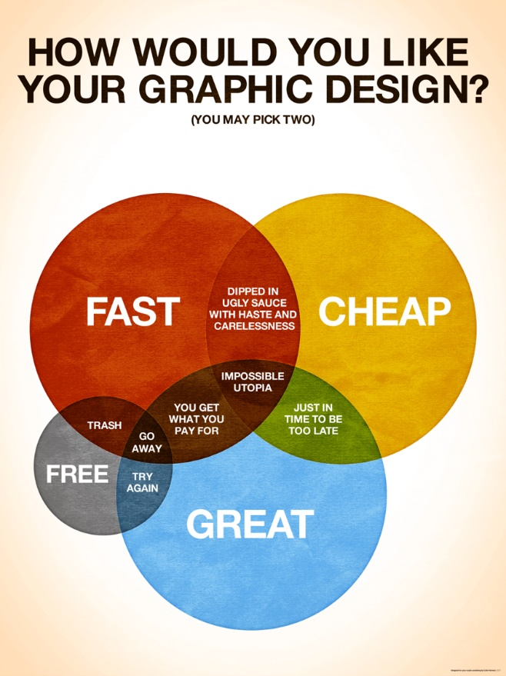
Good Cheap Fast
Pick Two
Notes:
Good – Cheap – Fast are similar to Scope– Resources – Time in the PM Triangle or triple constraint. All three at the same time are difficult to achieve.
PMs have a problem: Computer hardware has steadily become better, faster, and cheaper for over 60 years. So have telecommunications. Compare your first PC with, if you are old enough, an analog modem card to the machine you have now with a built in 1Gb network port. Moore’s Law: computing power of Integrated Circuits doubles every ~18 months at no increase in cost per IC.
The only exception this has been Apple. There is never a cheap option. In fact, an iPhone continues to get relatively more and more expensive.
Looking backward at hardware development sets expectations when looking forward to software development. But software does not obey Moore's Law. Software is made by people and people have not become many orders of magnitude faster, better, or cheaper in the last 7 decades. There is no economy of scale when creating software as there is when producing microchips. Yes, software tools are much better now than the ones invented by the women known as the ENIAC 6 (who invented binary trees, sorting, breakpoints for debugging, and the foundational concepts for programming languages and compilers). But software cannot meet the same expectations clients have come to expect from their hardware. Microchips are made from silicon, software applications are made from ideas.
https://ee.stanford.edu/~hellman/opinion/moore.html
$1 of computational power available from Amazon Web Services today gets you 385 MFLOPS or the power of 769,840 ENIACs in 1946. see https://www.theregister.co.uk/2019/06/20/supercomputer_aws/
Today, ENIAC's same computational power is used in greeting cards that play you a tune. Imagine the reaction if Time magazine, in its cover story about the ENIAC (worth $5.3M in 2019 dollars), had predicted: seventy years in the future, millions of hand-held, self-powered ENIACs will be bought for a few dollars at the corner store, used for 30 seconds and thrown away. No one would have believed you.
The 1946 ENIAC occupied 1,800 square feet and weighed more than 25 tons; it could execute 5,000 addition/subtraction/multiplication instructions per second or 500 FLOPS (floating point operations per second) for division. The iPhone 11 is 80cm-square and weighs 194g; its A13 Bionic processor does 155 billion instructions per second.
The slowest of today's 500 supercomputers crunches a petaFLOP—or 1,000,000 GFLPOS. https://www.top500.org/news/top500-becomes-a-petaflop-club-for-supercomputers/ https://pages.experts-exchange.com/processing-power-compared
https://aiimpacts.org/trends-in-the-cost-of-computing/ (about 12 orders of magnitude difference between 1946 and 2007, i.e. a trillion) estimate FLOPS grow by an order of magnitude every 7.7 years or 1 FLOP in 1946 = 9.35B in 2018
http://blogs.luc.edu/itshelpdesk/2013/02/07/the-history-of-processing-power/
http://money.cnn.com/interactive/technology/computing-power-timeline/
https://www.popsci.com/supercomputers-then-and-now http://allthatsinteresting.com/first-computer
https://technical.ly/philly/2011/02/15/eniac-10-things-you-should-know-about-the-original-modern-super-computer-65-years-later/ https://www.huffingtonpost.ca/entry/watson-scientific-computing-lab_n_2592670
Graphic from www.colinharman.com
Animated gif from http://missingcloud.com/gif/GoodCheapFast_MissingCloud_.gif
https://www.business.com/articles/fast-good-cheap-pick-three/
https://berkonomics.com/?p=2437

Slide 16
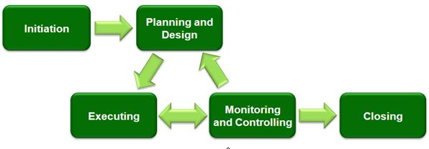
Project Management Process Groups
Notes:
https://www.linkedin.com/pulse/20140611182435-12732154-5-steps-to-a-successful-implementation-of-ict-projects
These processes can occur multiple times within a project: at each major phase/stage or sub-project
Initiation
Project Level:
Sponsor defines project objectives, agrees to scope, and grants authority to the project manager.
The sponsor is the client, customer, senior management of the company.
Sub-Project or Phase/Stage Level:
Project Manager decides order of sub-projects/phases, aligns resources and stakeholders.
The sponsor/acceptor can be the client’s Business Analyst, Division Director, or Dept. manager depending on scope of work.
Planning
Project Manager determines scope, work breakdown structure.
A work breakdown structure is a key project deliverable that organizes the team's work into manageable sections.
https://en.wikipedia.org/wiki/Work_breakdown_structure
Executing
Puts the project plan into motion and performs the work of the project.
Controlling
Measures the performance of the executing activities and compares the results with the project plan.
Note these middle three processes are iterative. This is where a PM’s skills at problem solving and leadership are heavily used.
Closing
Documents the formal acceptance of the product at this phase and brings all aspects of the phase to a close.
Lessons Learned are documented: how to repeat success, how to avoid failures.

Slide 17
SMART objectives
SMART objectives complete a project's goals
Everyone knows what they will do in each Process Group
Specific Measurable
Agreed on
Realistic
Time based
Notes:
This is a business standard for managing a team. It is how to tell people what is expected.
It is also your checklist to ensure your manager is giving you achievable goals before you accept them.
Each person manages their own work…
TO DO items: Specific objectives and tasks which were Agreed upon
DOING: an item according to a Time-Based target – hours of effort completed by a due date & time
DONE: items that were Measured as completed
HUNG UP: an aspect of an item became unRealistic
See Final Assignment Plan.docx
https://en.wikipedia.org/wiki/SMART_criteria

Slide 18
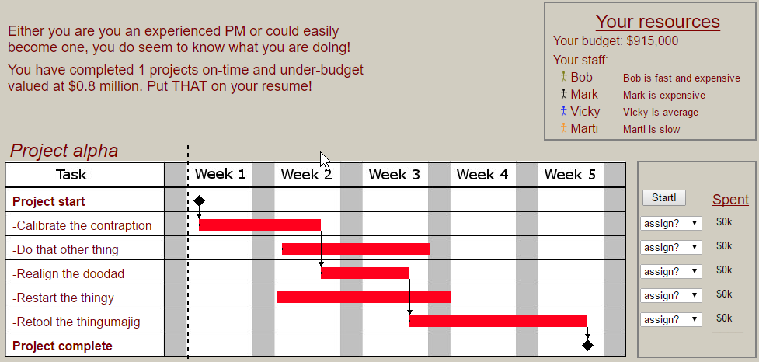
PM test at http://thatpmgame.com/
Notes:
Scope – Time – Resources in the PM Triangle or triple constraint.
http://thatpmgame.com/
Plan by putting available resources on the Gantt chart to complete tasks on time and on budget.
This
chart shows what tasks are prerequisites to the start of next tasks, i.e. schedule dependencies.
More on WBS and Gantt charts in the Notes slides below.

Slide 19

Advantages of Project Management & Project Management Certification

Slide 20
Advantages of Project Management
Better control of financial, physical, and human resources
Shorter development times
Better internal coordination
Lower overall costs
Improved productivity
Higher worker morale
Higher customer satisfaction
Project Management is the fastest growing job category today!

Slide 21
Project Manager Professional (PMP)
Project Management is a profession and project managers must follow a Code of Ethics.
Project Management Institute provides training and certification. (www.pmi.org)
Seneca College is a registered education provider (R.E.P) of PMI.
Notes:
In order to gain PMP certification you must pass the exams and agree to the code of ethics.
The number of people adding PMP to their resume is increasing quickly. Consider adding it to yours.

Slide 22
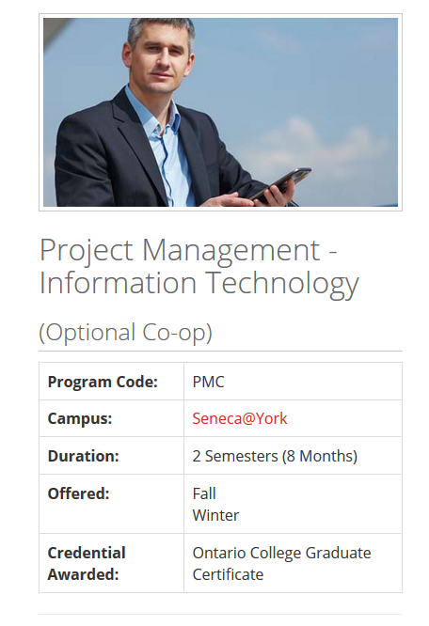



PM and more at Seneca College
Full and part-time graduate certificates in FinTech and Security. Certification & Professional Development Courses
Notes:
URLs linked to images including Seneca Downtown.
https://www.senecacollege.ca/programs/fulltime/PMC.html
https://www.senecacollege.ca/ce/business/management-human-resources/advanced-project-management.html
https://www.senecacollege.ca/ce/business/management-human-resources/business-analysis.html

Slide 23
Notes
You will need these for today's activity.

Slide 24
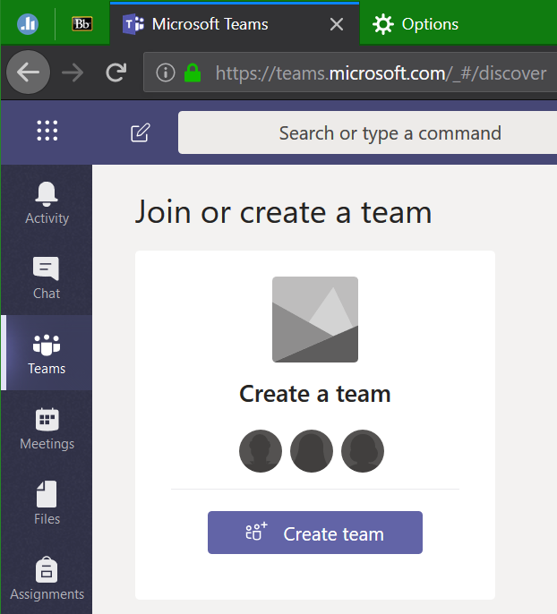

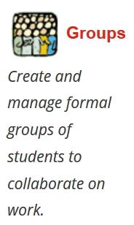
Join a Bb group, Create an Office 365 Team

Slide 25

Initiation
Initiation
Typically a company has a problem and defines a plan to solve the problem which is approved by management.
The Plan is a very “high-level” plan which defines the objectives to be achieved.
And typically grants authority to hire a Project Manager (PM)

Slide 26

Planning
Project Scope: work to be delivered which will support business objectives, goals, and benefits.
The Project Manager (PM)
defines project parameters through consultation with stakeholders. typically: Senior Management, Key & End Users, Technical Staff
ensures the project's objectives – delivery of scope – are realistic, achievable, and deliverable.
details the project scope so all stakeholders fully understand the work to be done (and not done).
estimates project costs, sets delivery schedule, defines value.
Notes:
https://en.wikipedia.org/wiki/Scope_(project_management)
Correctly defining the Scope leads to:
Ability to break the work done into concrete steps.
Understand the total cost of the project.
Tender contracts to complete the project.
Assign responsibility for key components.

Slide 27
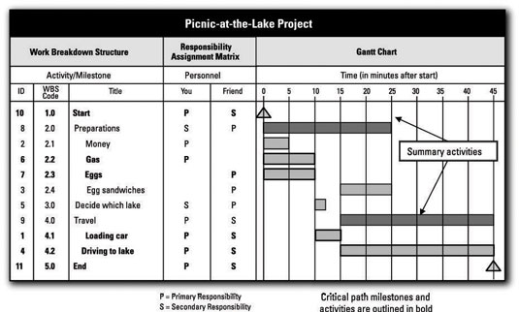
Planning – Work Breakdown Schedule (WBS)
WBS breaks Scope into tasks (details of what must be done, not how) with estimated hours and needed skill levels.
A Gantt Chart gives the overall timeline for work-packages to be assigned to people or technical roles.
Notes:
http://www.dummies.com/careers/project-management/4-ways-to-display-your-projects-schedule/#slide-3
https://en.wikipedia.org/wiki/Work_breakdown_structure
A WBS is not an exhaustive list of work. It is instead a comprehensive classification of project scope.
A WBS is neither a project plan, a schedule, nor a chronological listing. It specifies what will be done, not necessarily how or when. That said, budgets, and estimates, hours per WBS item and related labour rates are also needed.
Gantt charts and Critical Paths address who, how, and when tasks are completed.
General rule of WBS tasks is the 8/80 rule. A task's work can be accomplished in 8 hours and not more than 80 hours or 1 day to two weeks.
A work package at the activity level is a task that:
can be realistically and confidently estimated;
makes no sense practically to break down any further – the task description is enough for an expert to understand;
produces a deliverable which is measurable; and
forms a unique package of work which can be assigned to a known person, a technical role, outsourced, or contracted out. A skilled person could go away and complete the work package.
Tasks are acquisition of hardware, creation of software, and deployment/installation activities; these are all measurable deliverables.
A person-month is 120 – 150 hours, that is billable or task productive hours. It takes into account statutory holidays and administrative time.
https://en.wikipedia.org/wiki/Gantt_chart
A Gantt chart should also show what tasks are prerequisites to the start of next tasks, i.e. schedule dependencies.
A similar technique is using the Critical Path Method to construct a model of the project that includes the following:
A list of all activities required to complete the project (typically categorized within a work breakdown structure),
The time (duration) that each activity will take to complete,
The dependencies between the activities and,
Logical end points such as milestones or deliverable items.
This gives greater granularity in scheduling overlapping non-dependent activities, which set of dependent activities require the longest timelines, and where the schedule might be "crashed" by shifting more resources towards the completion of an activity.
https://en.wikipedia.org/wiki/Critical_path_method

Slide 28
Planning – Budget of estimated costs
Equipment description | units | $/unit | Estimate
Component A (details & configuration) | 1 | 9,234.50 | 9,234.50
Component B (details & configuration) | 79 | 987.65 | 78,024.35
Component C (details & configuration) | 83 | 345.67 | 28,690.61
Equipment total |  |  | 115,949.46
Services description | hours | $/hour | Estimate
WBS task category 1 | 87.5 | 99.00 | 8,662.50
WBS task category 2 | 190.0 | 24.00 | 4,560.00
WBS task category 3 | 63 | 150.00 | 9,450.00
Services total |  |  | 22,672.50
Notes:
WBS estimates detailed tasks, estimated hours @ skill level.
General categories of tasks by skill level are summarized for the budget.
Budget applies hourly cost of a skill level to estimated hours.

Slide 29

Executing
Starts after client approval and team agreement of the project plan for cost/resources, schedule/time, scope/quality.
PM coordinates with client for time and space, allocates resources, sources equipment, assigns tasks from WBS, communicates between and within stakeholder groups.
PM performs quality assurance on project phases, ensures task completion with quality control.

Slide 30

Monitoring and Controlling
Project Manager continually measures the performance (cost/resources, schedule/time, scope/quality) of all activities and compares the results with the project plan. PM is responsible for delivering value to the client.
How to identify problems quickly and take corrective action?
Monitoring task progress:
Where are we now?
Monitoring variables:
Plan vs Actual (timeline)
Budget vs Actual (costs)
Where should we be now?
Identifying corrective actions:
How can we get back on track?

Slide 31
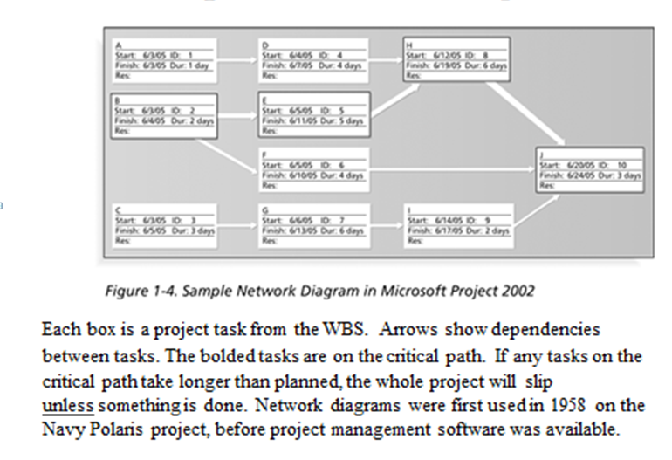
Controlling (Cont’d)
Today, mostly Software is used to control projects.
There is specialized software for small, medium and large projects.
The software here shows the “critical path.”
Notes:
http://www.dummies.com/software/microsoft-office/project/10-golden-rules-project-management/

Slide 32

Closing
Documents the formal acceptance of the project’s product and brings all aspects of the project to a close.
Closing includes the formal acceptance of the project and the ending thereof. Administrative activities include the archiving of the files and documenting lessons learned.
This process group consists of:
Contract closure: Complete and settle each contract (including the resolution of any open items) and close each contract applicable to the project or project's phase/stage.
Project closure: Finalize all activities across all of the process groups to formally close the project or project's phase/stage.
Post Implementation Review: This is a vital phase of the project for the project team to learn from experiences and apply to future projects. Normally a Post Implementation Review consists of looking at things that went well and analyzing things that went badly on the project to come up with lessons learned.

Slide 33
Why there is a need for Project Management?
Project Scope: "The work that needs to be accomplished to deliver a product, service, or result with the specified features and functions."
Top 5 Reasons for Project Management http://sambit-daspatnaik.blogspot.ca/2012/10/top-5-reasons-why-we-need-project.html:
deliver within scope, on time, within budget
deliver with quality
ensure productivity
prevent re-work
avoid blame gaming
Notes:
https://en.wikipedia.org/wiki/Scope_(project_management)
Using sound project management techniques and processes will give you a higher likelihood that your project will be completed on time, within budget and to an acceptable level of quality.
1. Are you going to manage scope or deal with cost and deadline overruns caused by doing more work than your budget covers?
A project's Scope statement defines and controls what is and, potentially, what is not included in the project.
2. Are you going to build quality into your process or fix problems later when they will be more costly to resolve?
3. Are you going to communicate proactively or deal with conflict and uncertainty caused by a lack of project information?
4. Your project will face potential risks. Do you want to try to resolve them before they happen or wait until the problems arise?
5. Your project is going to face issues. Do you want to proactively resolve them or figure them out as you go?
http://www.tensteppm.com/open/A1ValueofPM.html
Top 5 Reasons why we need Project Management Processes
We all follow Project Management processes in our projects. Mostly, they are tailored to meet the requirements of the project. Some projects need tighter control and more stringent processes that might have been mandated in the contract, while some need processes sufficient to self manage and execute the project to meet the deadlines and quality standards. Whatever be the reasons, if we don’t follow certain processes, it will definitely jeopardize the project.
Here are top 5 reasons why we need to follow processes:
1) To meet the deadlines: This is first and foremost. Many times, there are delays in deploying the project at the client’s site because there is no process defined for uploading the software or patches in the customer’s environment. Important steps like build packaging, testing the smooth installation are left out if these are not mentioned in a standard to do checklist. This can cause the team to run around for last minute activities that may result in more problems identified at the last minute. This inadvertently delays the final delivery of the project or product to the customer.
2) To maintain the right quality: If certain processes or tasks are missed, a high number of defects will be raised at the customer end. Some of them can be precarious such as an interactive website not opening at all for the end user (Obamacare launch), or payments being incorrectly processed (Target Canada).
3) To ensure productivity: If processes are not maintained and followed, it can result in tasks or activities being identified in an ad hoc manner with managers expecting team to stay late and complete work that could have been otherwise planned well in advance. The team will eventually burn out.
4) To prevent re-work: It costs $1 to create a business requirement, it costs $100+ to add it after Go Live.
Many a times, due to lack of process, the communication between team members and managers is less than adequate. Assumptions are made. Tasks are completed with a different set of objectives in mind. E.g., Software developer ending up writing code that result in performance issues in a mission critical product. This can cause the customer to wait for a long time for say, a financial transaction to happen. The team then ends up fixing the problem in the next build or release cycle causing more re-work.
5) To avoid blame gaming: All the above points lead to one major effect….Playing the blame game. Each team puts the blame to the previous team, or puts the blame of bad quality to production team. And this goes on in a vicious circle. Add political angle to it, and the project goes for a six. While all this could have been easily avoided by simply following right processes.
Japanese maxim: Fix the problem, not the blame.
(http://sambit-daspatnaik.blogspot.ca/2012/10/top-5-reasons-why-we-need-project.html)
https://en.wikipedia.org/wiki/Project_management
https://www.wrike.com/project-management-guide/methodologies/

Slide 34
Failure to define the project scope and taking into account all stakeholders, can lead to miss-defining the project and failure to complete the project
www.pmi.org web site PMBOK Guide

Slide 35
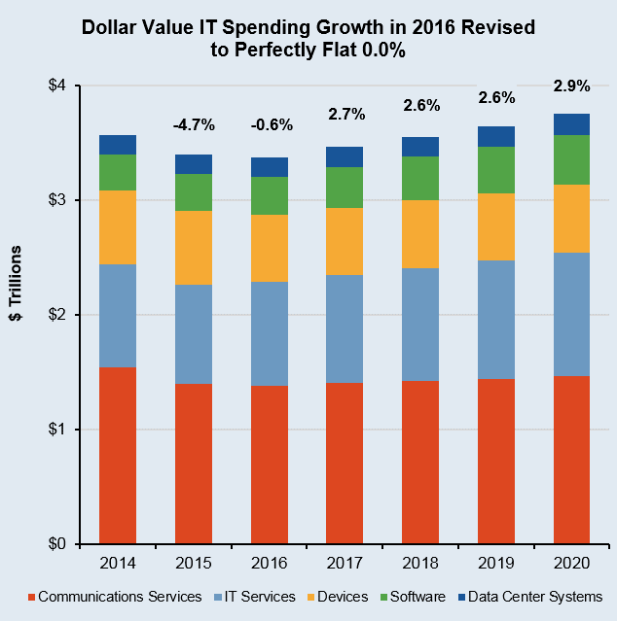
Worldwide IT Spending
Garnter Inc.
Notes:
Worldwide IT spending is projected to total $3.5 trillion in 2017, a 2.7 percent increase from 2016, according to Gartner, Inc. The worldwide IT services market is forecast to grow 4.2 percent in 2017. Buyer investments in digital business, intelligent automation, and services optimization and innovation continue to drive growth in the market. http://www.gartner.com/newsroom/id/3568917
The largest region for total IT spend in 2017 remains North America, with USD$1.19 trillion. However, the fastest-growing region is emerging Asia/Pacific, with 2017 constant-currency growth of 5.9% (revised up 0.4% from the 3Q16 update). The next-best region for growth is sub-Saharan Africa, with 2017 constant-currency growth of 5.2%, up 0.5% from 3Q16.
USD$3.464 trillion world-wide spending USD$900B in IT Services and USD$333B in Enterprise Software. Those last two areas are us in CPD/CPA. They are also the areas showing the strongest growth in the last few years historically and projected.
Seneca Library has access to the Gartner database. http://library.senecacollege.ca/res/Gartner.html
We had better know what we are doing. “good IT is expensive and bad IT is even more expensive”
http://calleam.com/WTPF/?tag=examples-of-failed-projects
http://calleam.com/WTPF/?p=8336
http://www.cbc.ca/news/canada/ottawa/phoenix-payroll-problems-ibm-1.3770947
Cdn Federal Gov’t Phoenix payroll system

Slide 36
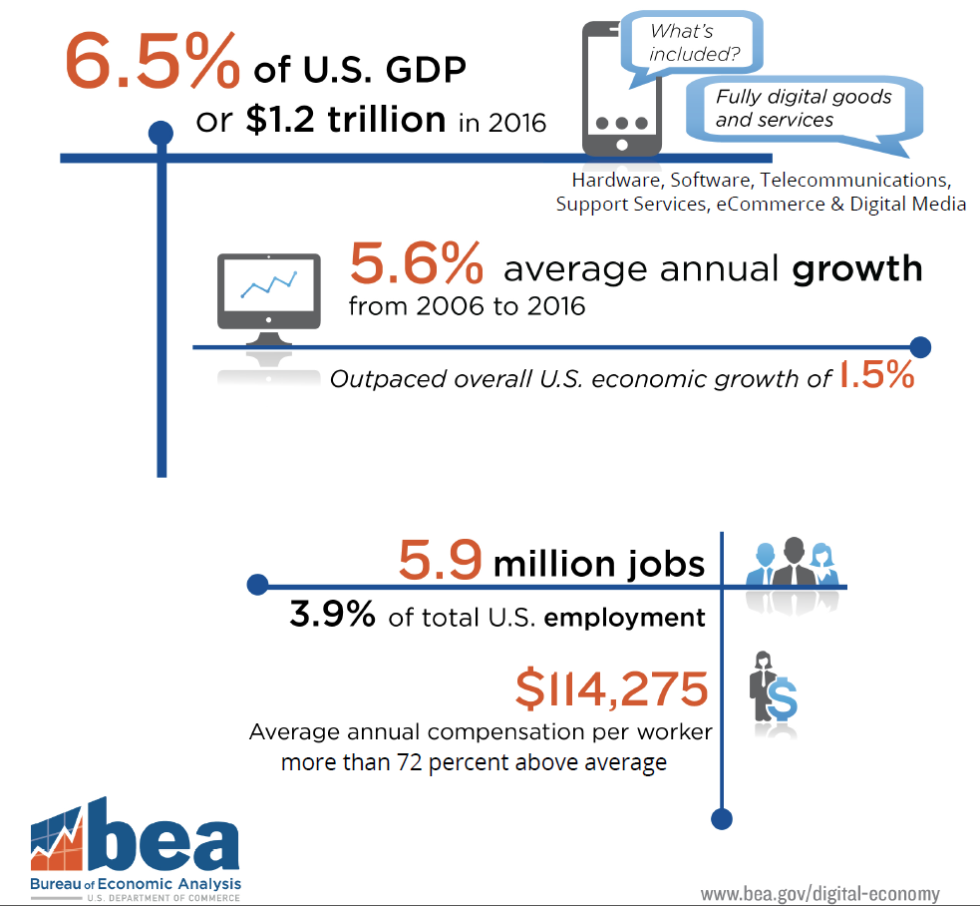

Slide 37
Jobs in Robotics are
Bringing back jobs in Manufacturing
Notes:
Jobs in Robotics are Bringing back jobs in Manufacturing
Local example of changes in the manufacturing industry:
General Motors has been in Oshawa, Ont., for 100 years. It has always been the city's largest single employer. For every job at the assembly plant, up to nine jobs additional are created in the community.
In the 1980s, General Motors invests $8-billion to improve its manufacturing capacity in Canada. The revolutionary GM Autoplex in Oshawa becomes the largest car assembly plant on the planet. approximately 23,000 people employsed in Oshawa.
Economic impact e.g. In 1996, a three-week strike of GM's hourly workers in Canada took at least $1-billion out of the Canadian economy.
In the early 2000s, GM invested more money to create state of the art manufacturing using robotics to reduce repetitive strain injuries in workers, allow highly flexible production, and reduce its carbon and environmental footprint.
The Oshawa plant has almost always been the highest quality and overall "best" plant in the North American auto industry.
By end of 2019, GM's last Oshawa plant will close eliminating almost 3,000 jobs. (GM is offering “special relocations to Oshawa employees for jobs at some of its other Ontario operations”, also enhanced retirement packages.)
In 2017, GM opened its Canadian Technical Centre (CTC) in Markham, Ontario to have 1,000 employees at full capacity, including 700 practising engineers. The facility will support GM’s advanced driver assistance features, fully autonomous vehicle program, and infotainment center design and improvements. GM also has R&D facilities in Oshawa, Toronto, and Kitchener-Waterloo. A test track for autonomous and advanced technology vehicles is being built now in Oshawa on the old GM Autoplex grounds supporting 300 jobs.
Okay
Th e last manufacturing jobs in Oshawa are turning into R&D jobs in the greater Toronto area. There is an economic improvement at the macro scale, but at the micro scale, engineering jobs are not manufacturing jobs.

